Slide 1
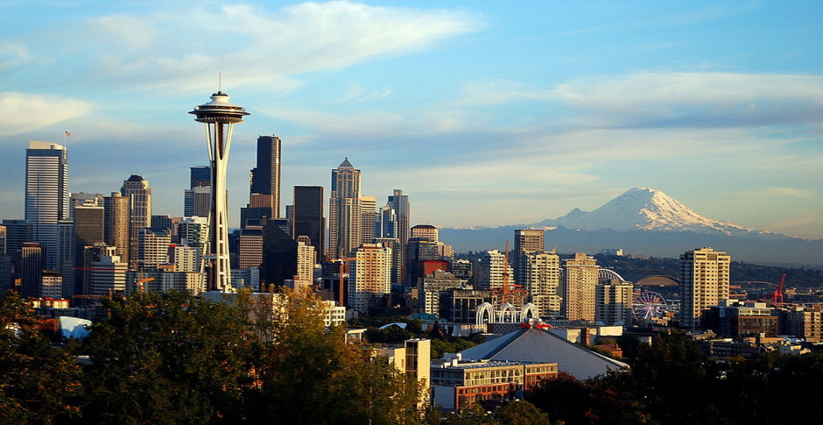
Electric Cars of Washington State
POOR6 – Riccardo Gobbo, Simone Merlo, Diego Spinosa
10/01/2024

Slide 2
Outline
01
02
Domain & Data Sources
Ontology
Domain, goals and data sources
Domain model
03
04
Queries & Data Analysis
Future Work
Queries, heatmaps and graphs
Future work & possible expansion

Slide 3
01 Domain & Data Sources

Slide 4
Domain
Electric Cars
Charging Stations
Plug-In and Battery cars registered in the state of Washington
Private and Public Stations to recharge electric vehicles
Adjusted Gross Income
ZIP Codes
Adjusted Gross Income (AGI) for each ZIP Code
ZIP Codes and related cities and counties

Slide 5
Goal
The goal of our work is to provide a knowledge graph to evaluate the electric vehicles accessibility by highlighting the correlation between:
The electric cars
The charging stations
The average income
of the people living in the state of Washington, focusing on the different territorial divisions.

Slide 6



Data Sources
Electric Cars
AGI
Charging Station
Plug-In and Electric (BEV) cars
2 possible sources:
Kaggle
data.wa.gov
Adjusted Gross Income for each ZIP Code
Data about Public and Private station to charge electric vehicles

Slide 7
02 Ontology

Slide 8
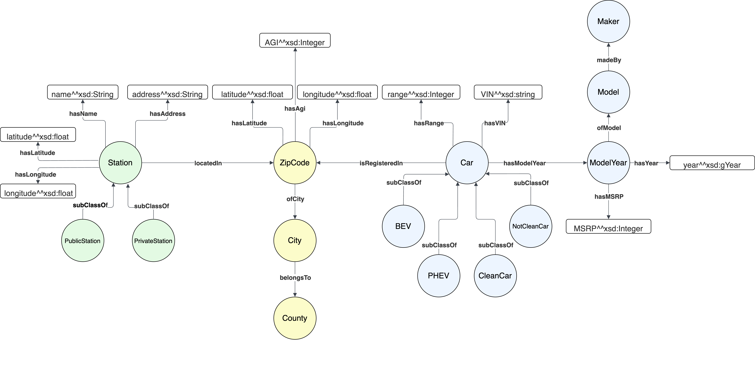
Ontology

Slide 9
03 Queries & Data Analysis

Slide 10
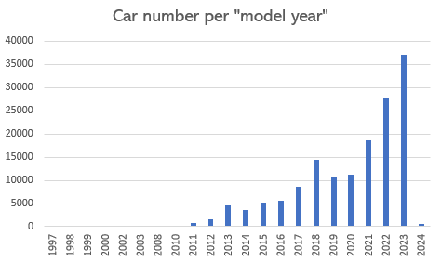
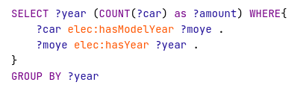
Cars Over Time
How many electric cars are registered for each model-year?
Indicator of EV adoption through time.
Notes:
DIEGO

Slide 11
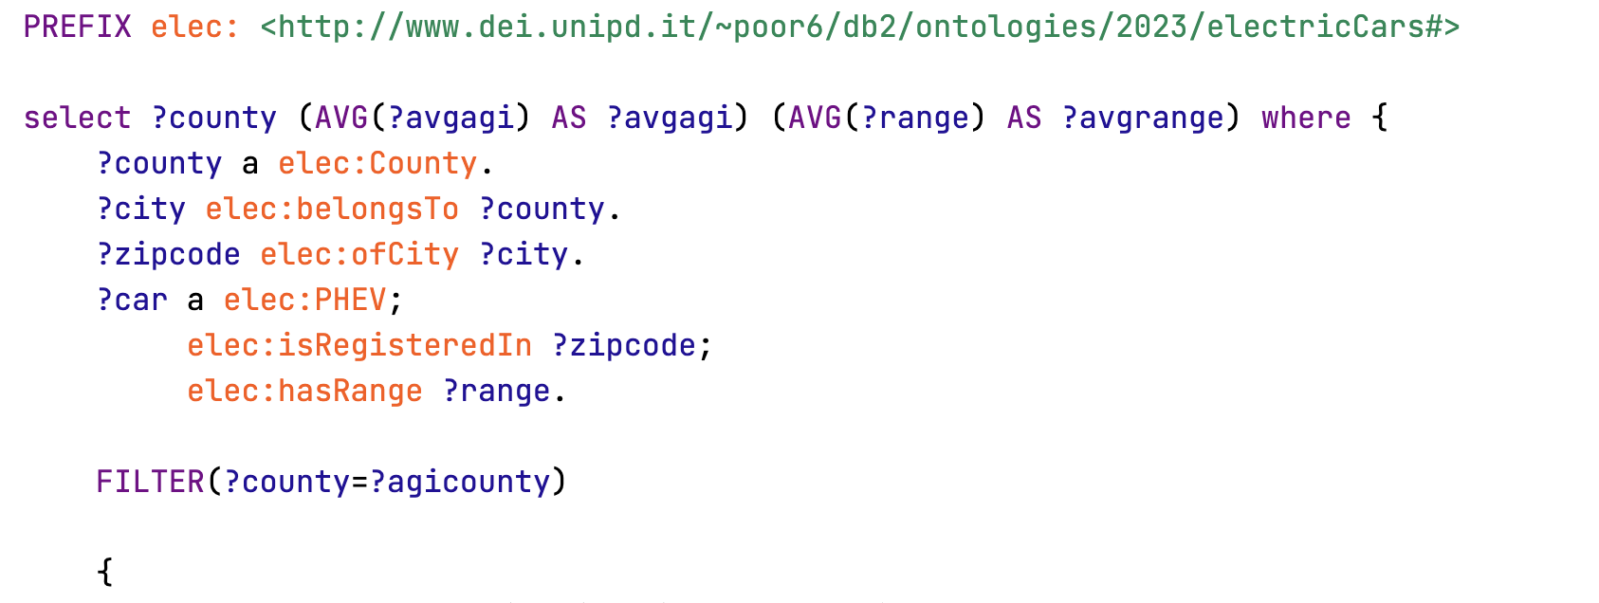
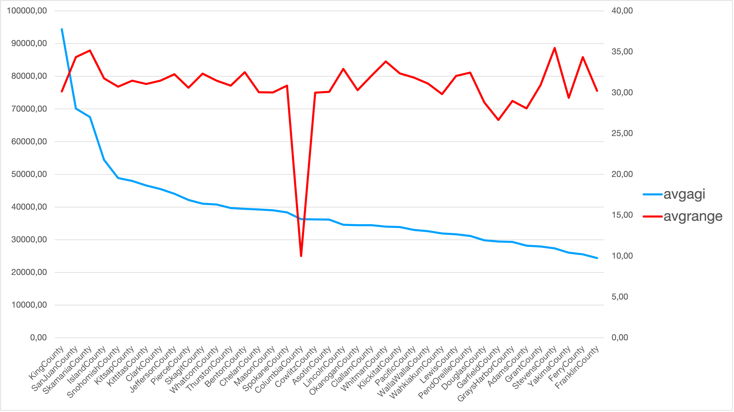
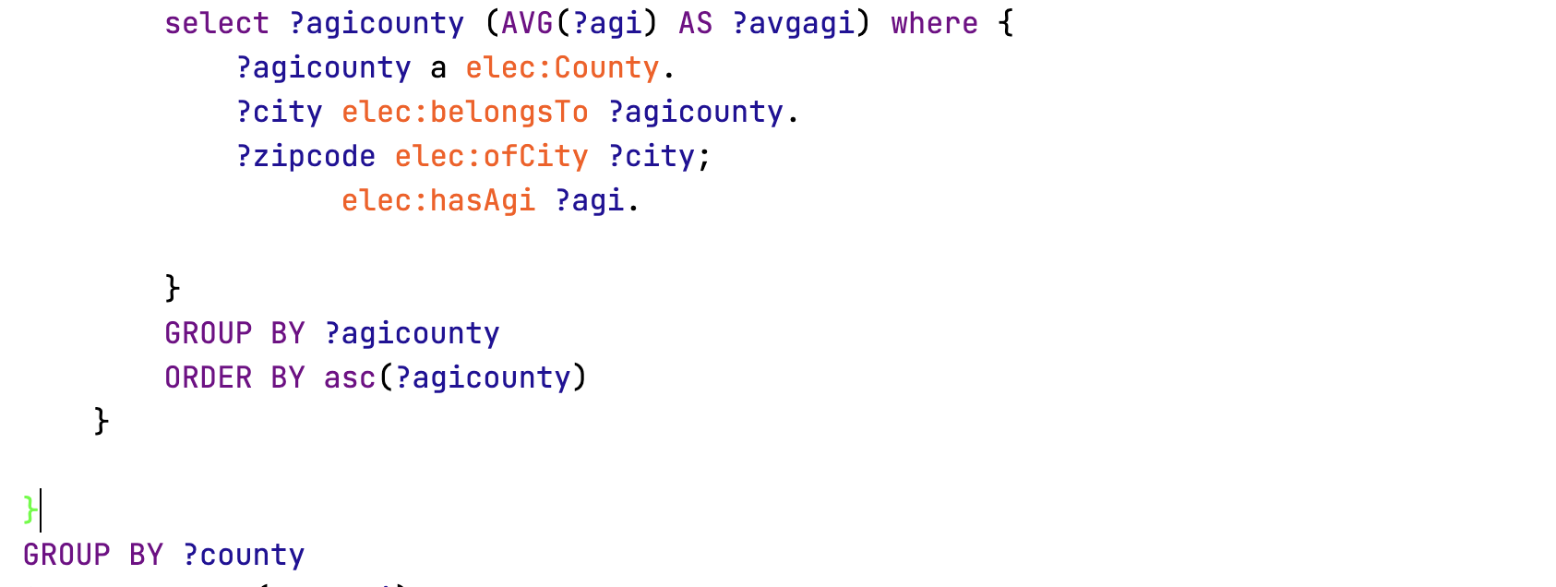

PHEV Cars Range and AGI
What is the average range of PHEV cars and average AGI for each county?
Do, on average, richer regions buy longer-range hybrid vehicles?
Notes:
MERLO

Slide 12
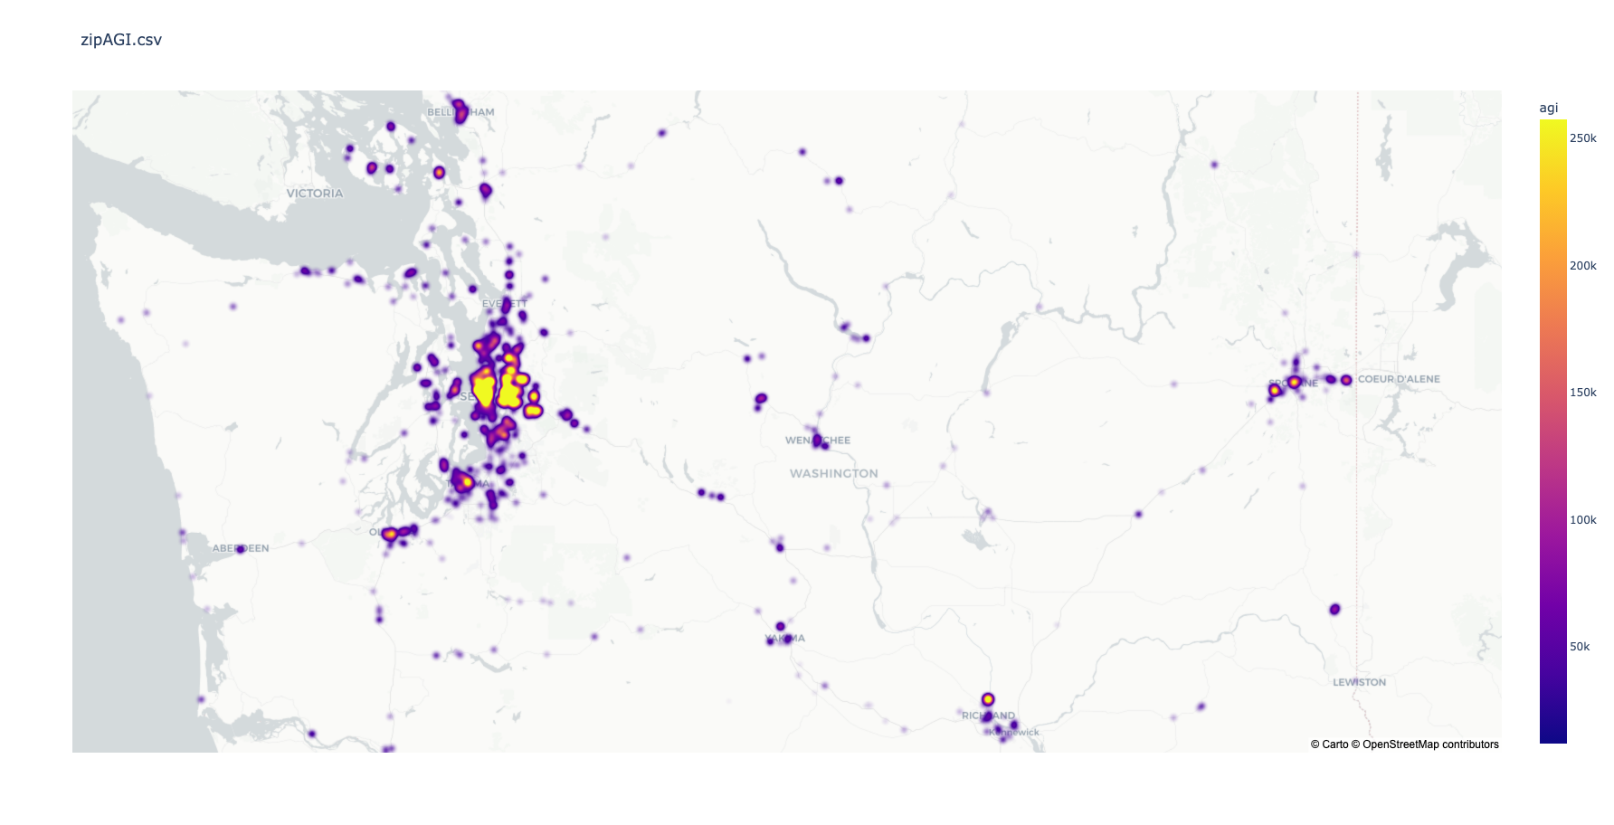
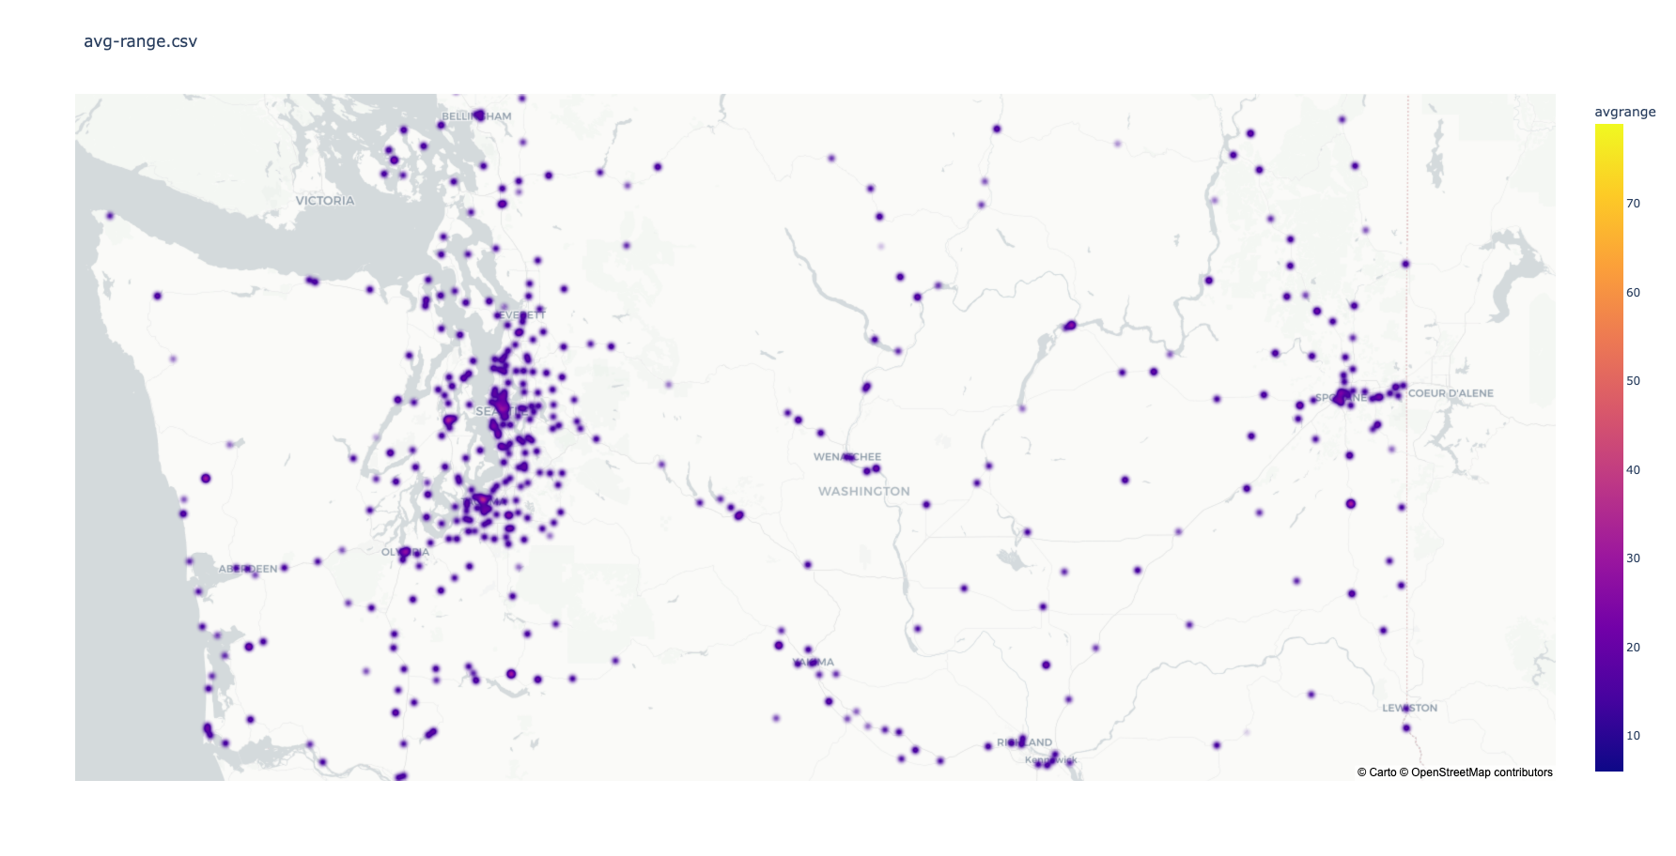
AGI distribution
PHEV car range
Notes:
MERLO

Slide 13
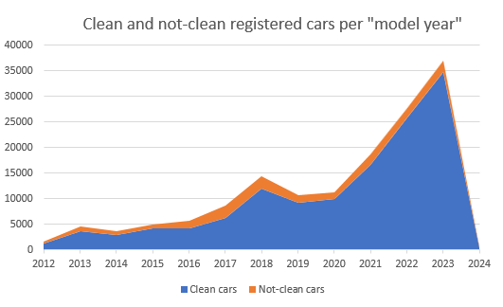
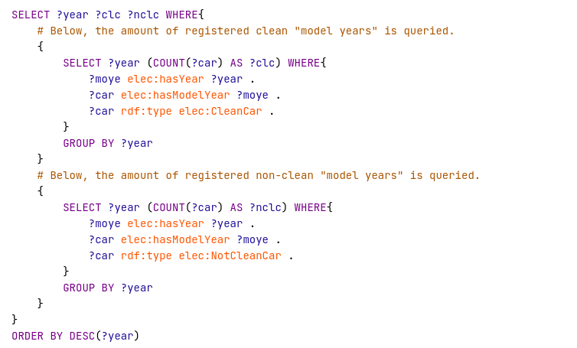
Clean and Not Clean Cars
What is the clean and non-clean car count for each production year?
Highlights how the amount of clear and non-clean registered vehicles varied over time and their proportion.
Notes:
In proporzione le not clean diminuiscono a dismisura per:
ModelYear: identificatore generazione macchina e non rappresenta l’anno di produzione (eg. Dati 2023 con model year 2024)
- Limitazioni tecniche per le macchine ibride dell’inizio e successiva evoluzione delle stesse che ha portato ad un maggior utilizzo
- Macchine sporche rimanenti: motivi di marketing su macchine grosse e pensanti

Slide 14
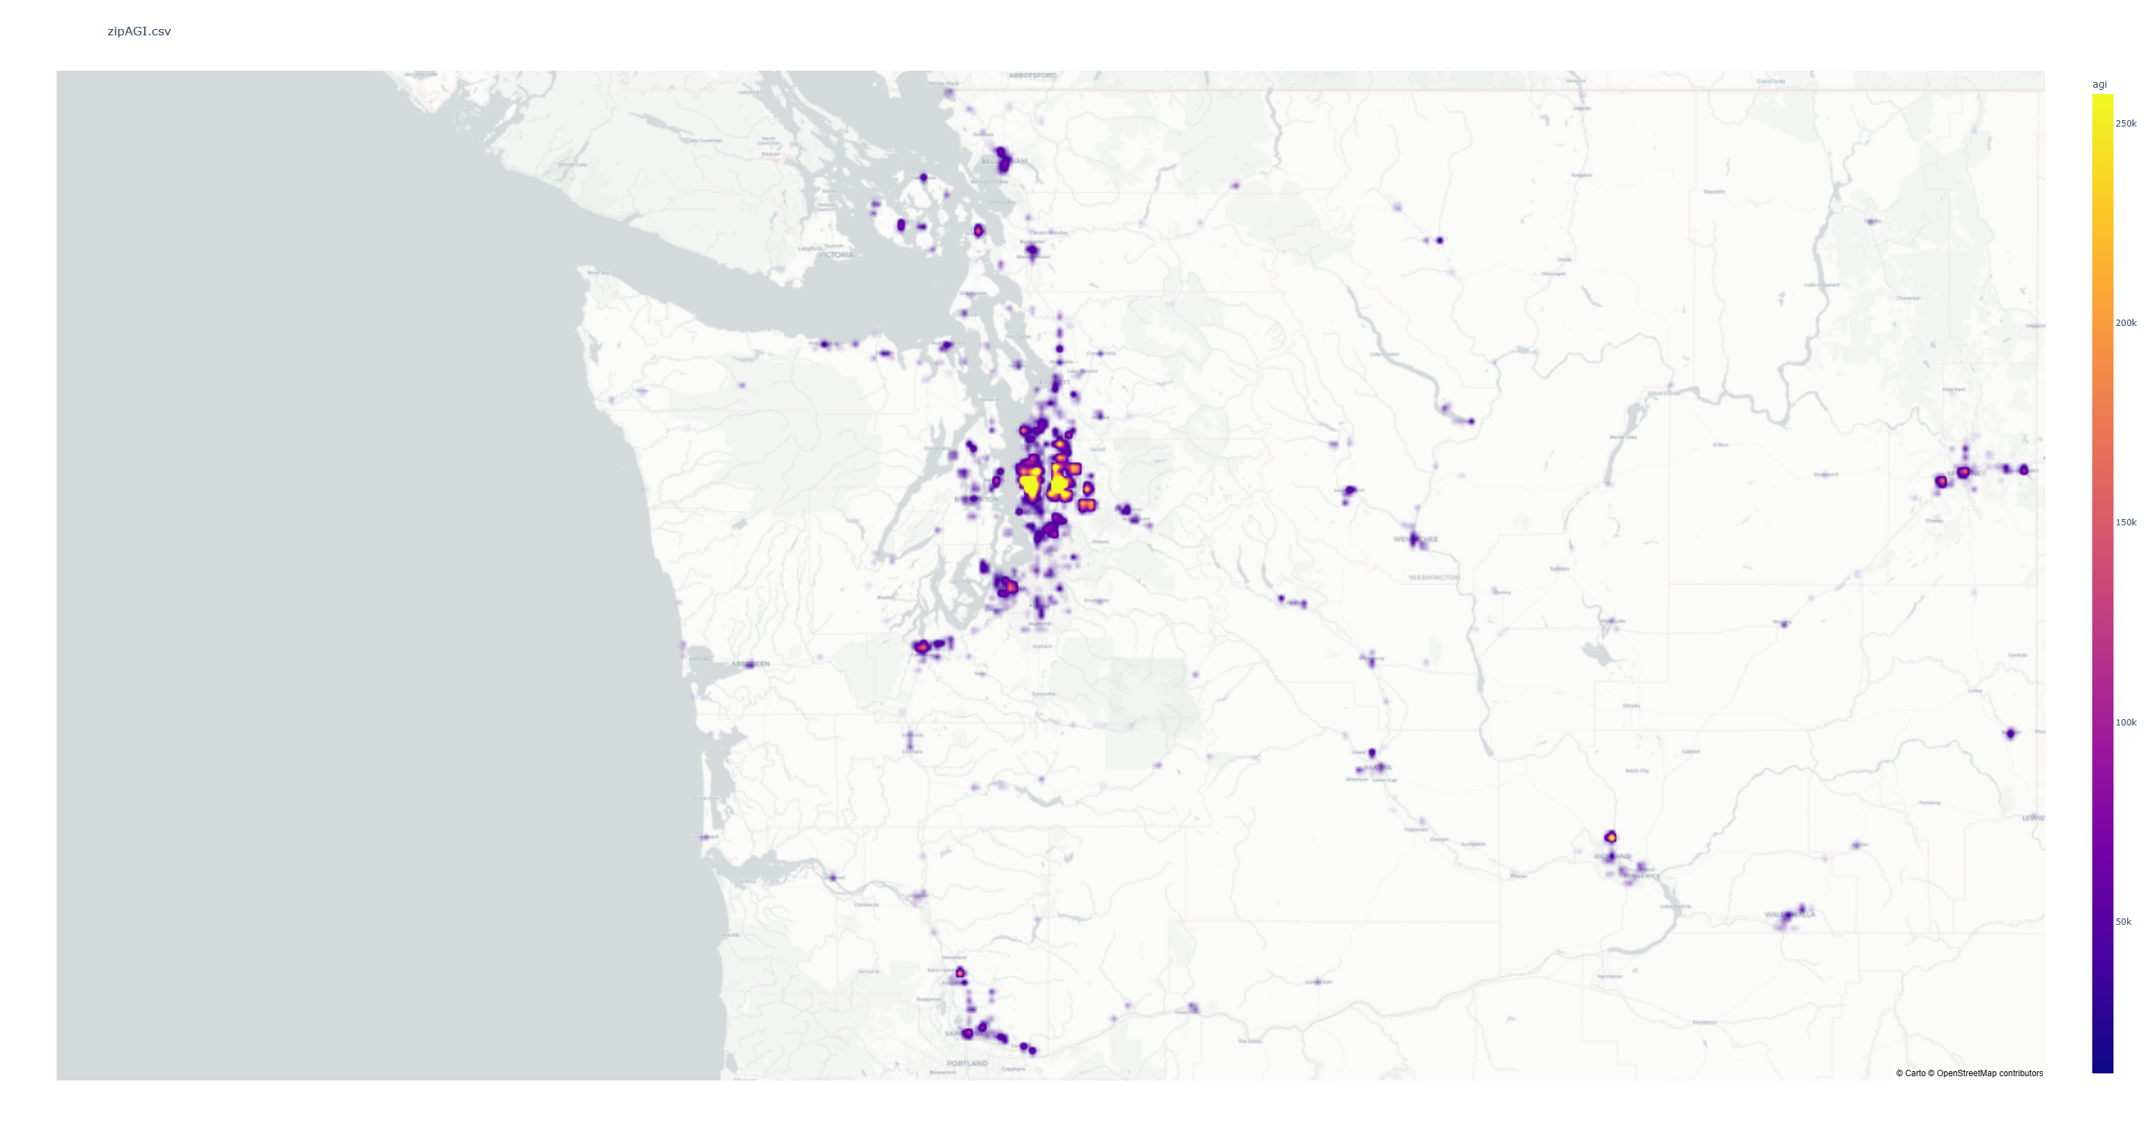
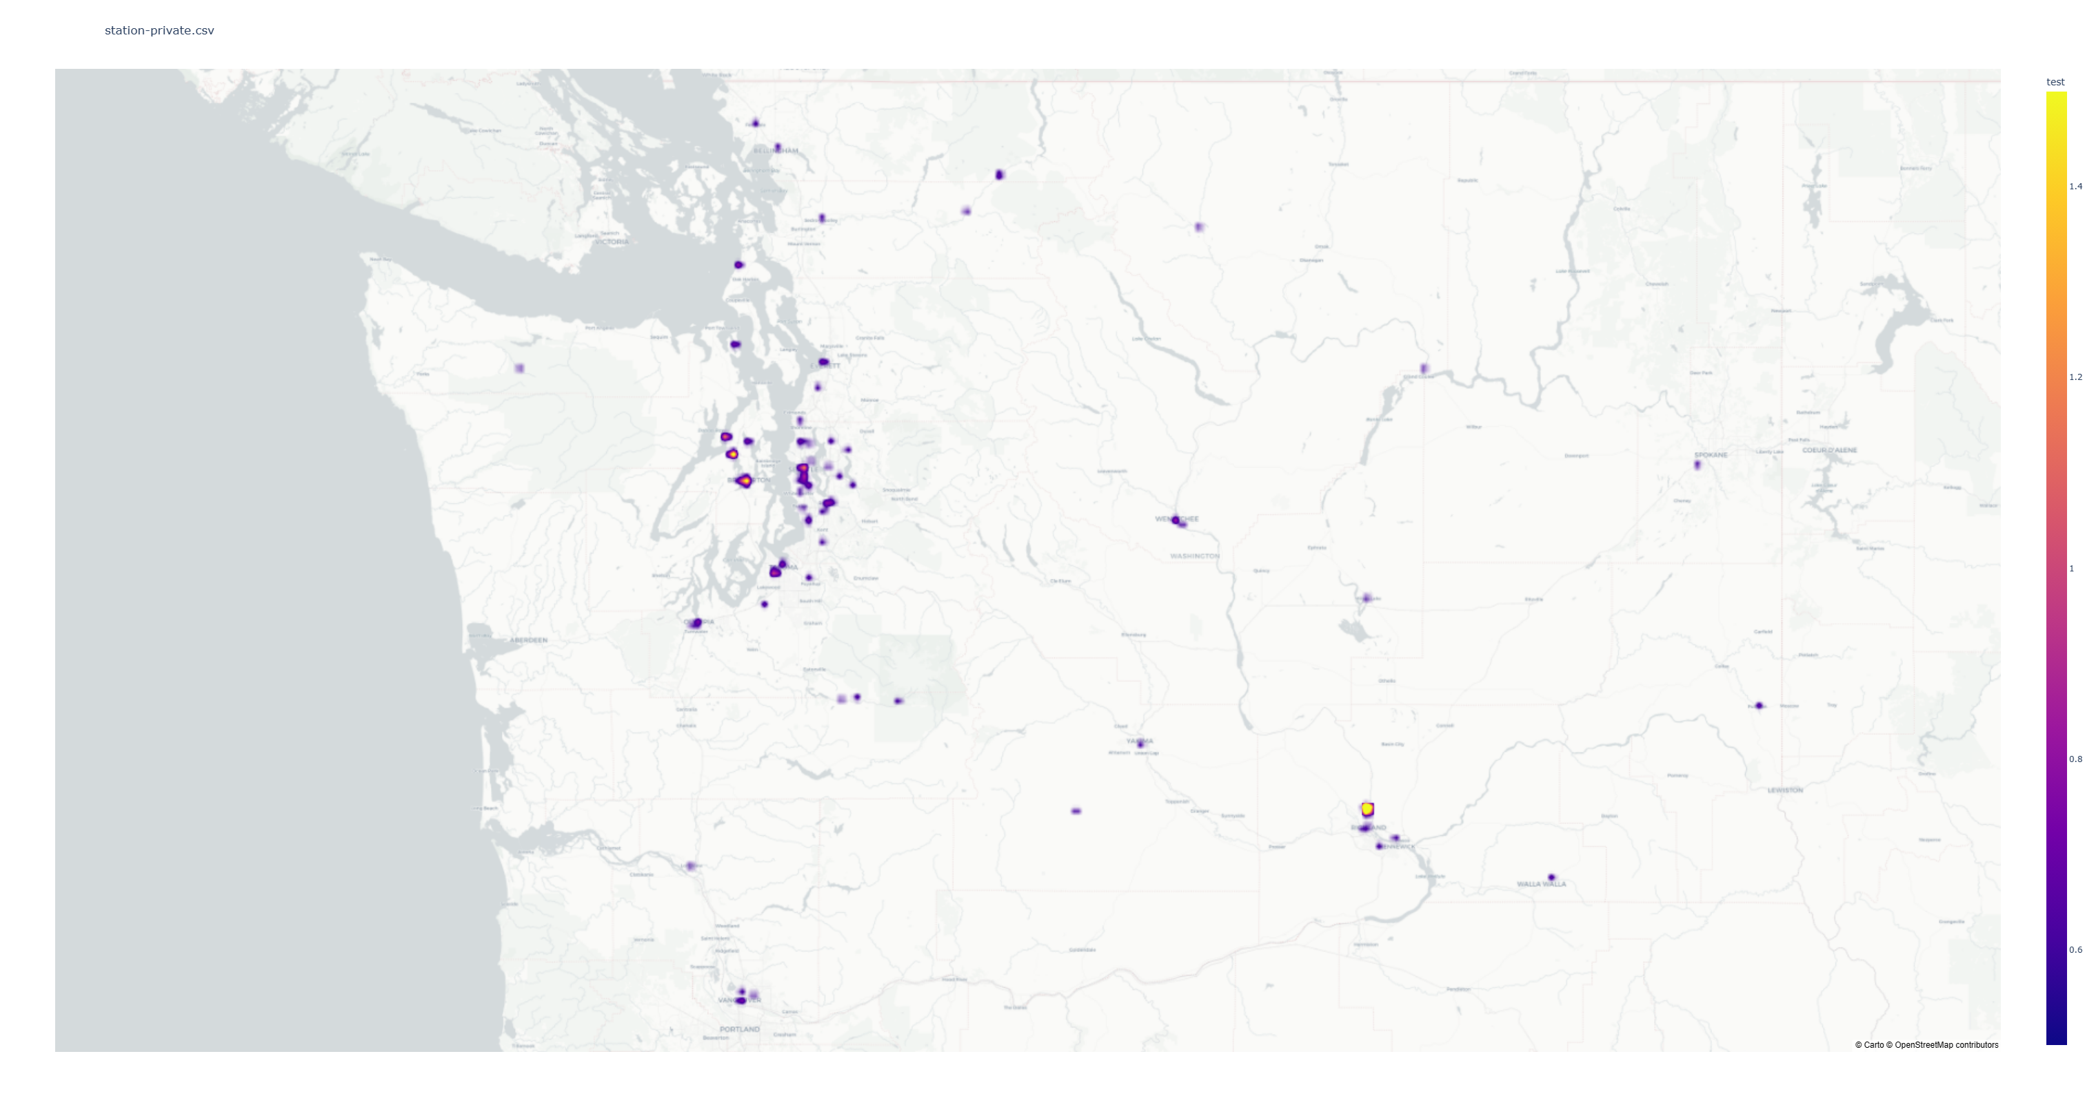
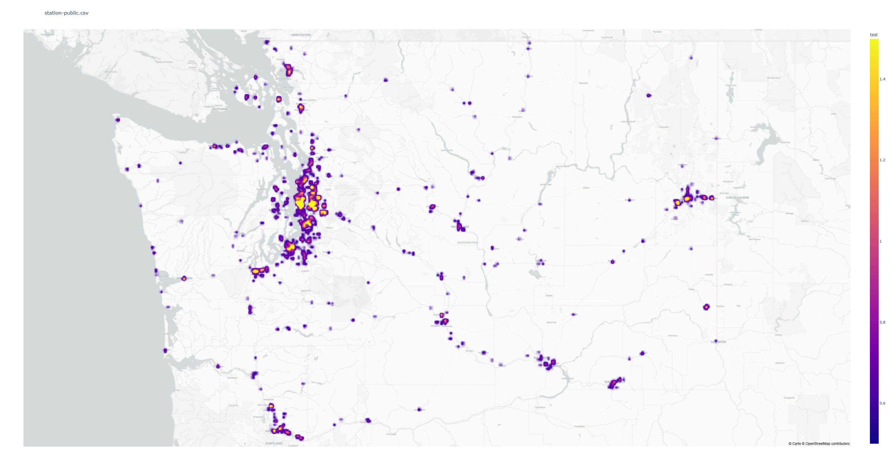
AGI and Station densities
What are the mean AGI and charging station amount/type distributions?
Highlights the eventual correlation between wealth and charging station density/type
AGI distribution
Private stations
Public stations
Notes:
Nelle zone piú ricche si concentrano il numero di stazioni pubbliche rispetto a quelle private

Slide 15

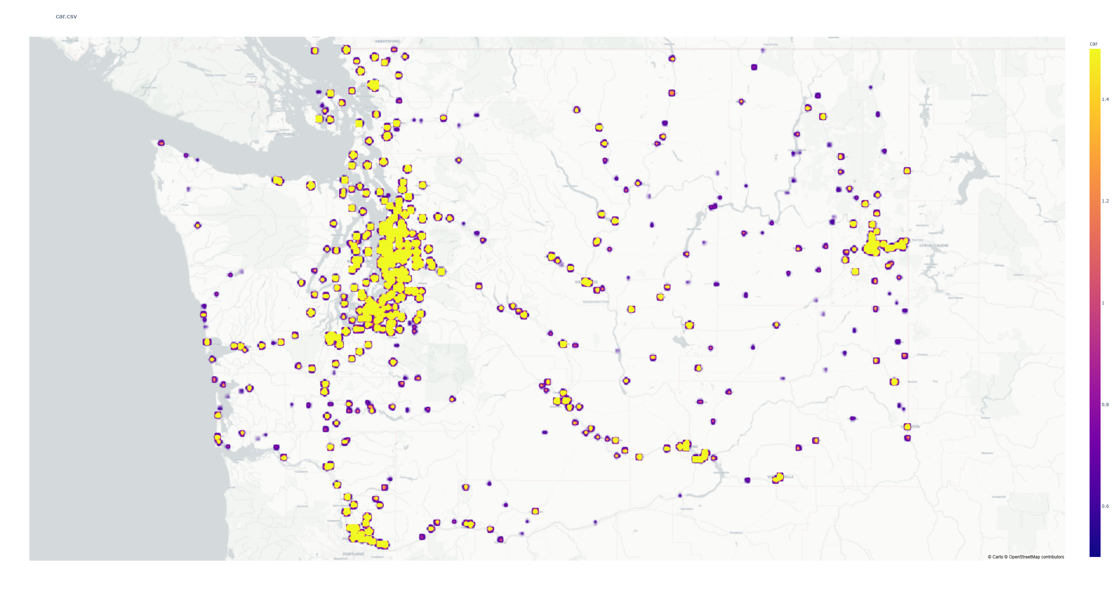
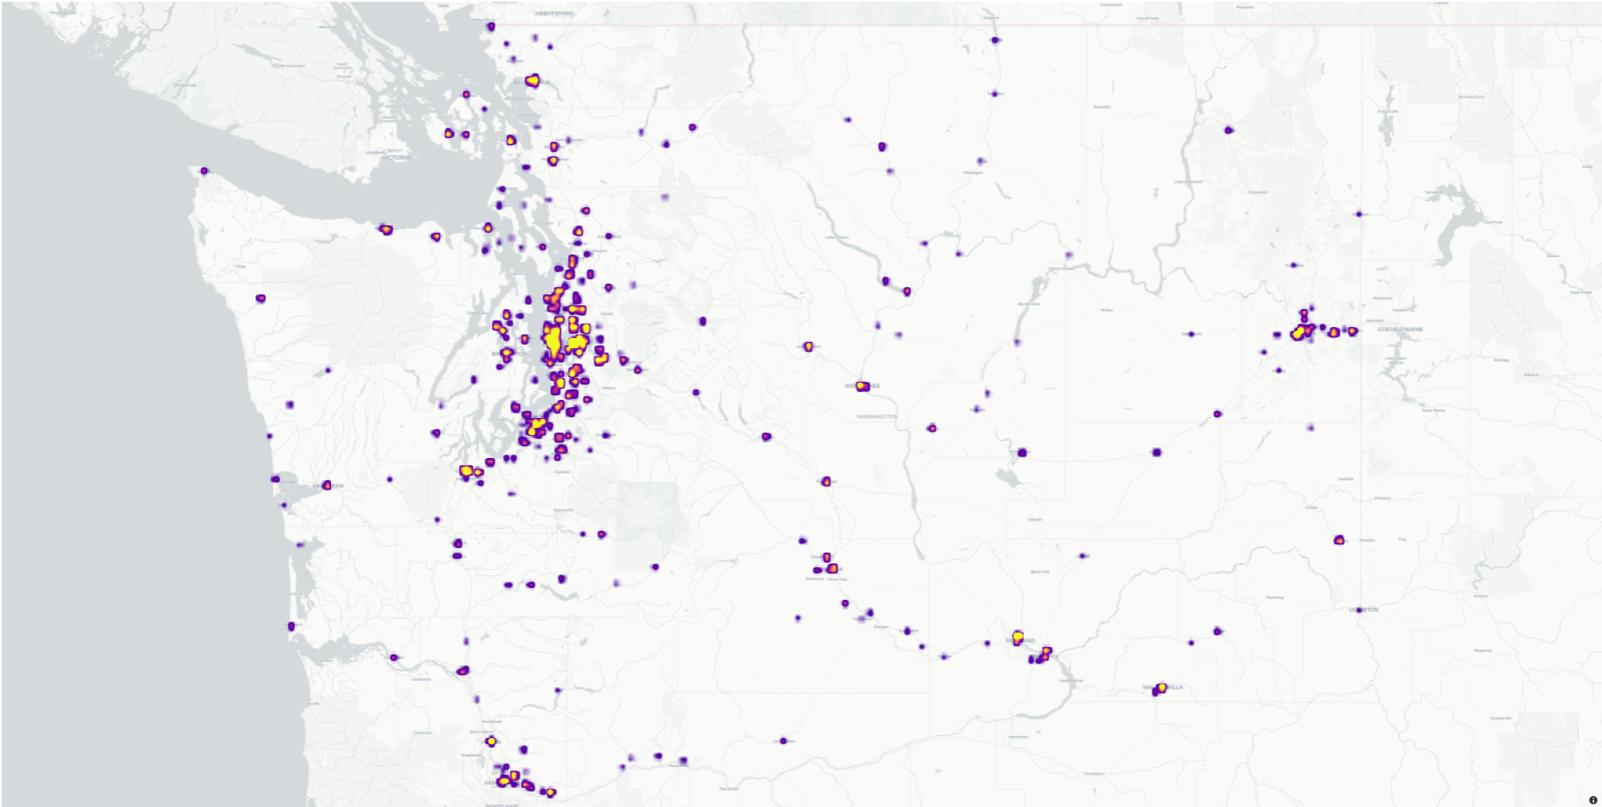
Car and Station densities
What are the car and the electric station distributions?
Highlights the eventual correlation between car density and charging station density
Car density
Station density
Notes:
Se chiede info sulla distribuzione delle persone -> non rientrava nei nostri scope iniziali e si puó aggiungere come future work

Slide 16
KG Applications
Car number-wealth correlation
Is income a limit to EV popularity?
Charging station-wealth correlation
Are charging stations evenly installed?
Charging station-Car number correlation
Does charging station density influence EV diffusion, both by limiting or supporting it?
Notes:
Potenzialitá del nostro lavoro, per esempio rispondere alle seguenti domande.
Car number – wealth correlation non c’è perché non l’abbiamo selezionata.

Slide 17
04 Future Work

Slide 18
Future Development & Expansion
Add more US States
Expand to Europe/World
Expand the kg with data from other US states
Challenge due to the ZIP Codes
Range of electric cars
Add power suppliers
Range of electric cars is not maintained since they are considered all clean
Need a data source to merge cars and stations power suppliers
Notes:
Add power suppliers: unire i dati tra macchine e fornitori elettrici per capire come le macchine si ricaricano, con fonti rinnovabili o no (sottolineare la difficoltá nell’impresa)

Slide 19
Thanks for your attention!

Slide 21
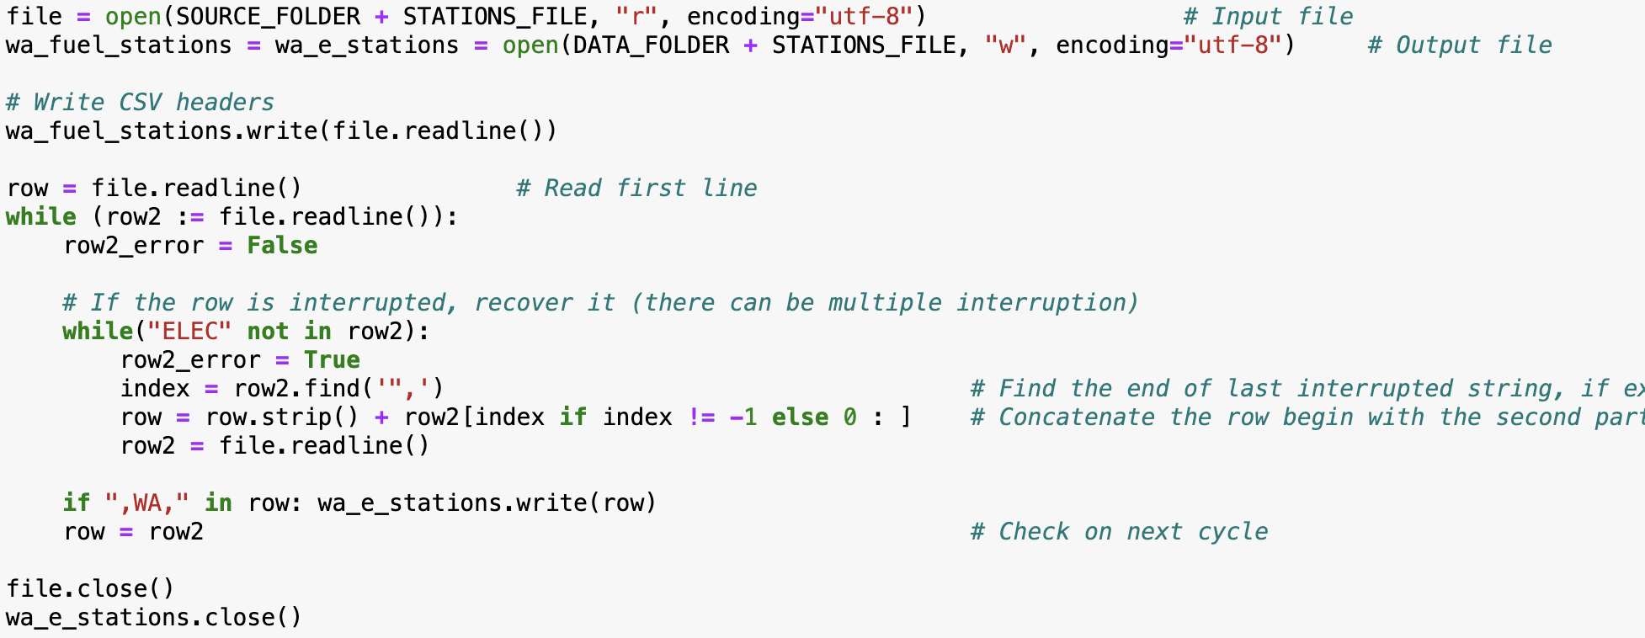
Serialization (1)
URI processing:
Stations File pre-processing:
Notes:
Potenzialitá del nostro lavoro, per esempio rispondere alle seguenti domande.
Car number – wealth correlation non c’è perché non l’abbiamo selezionata.

Slide 22
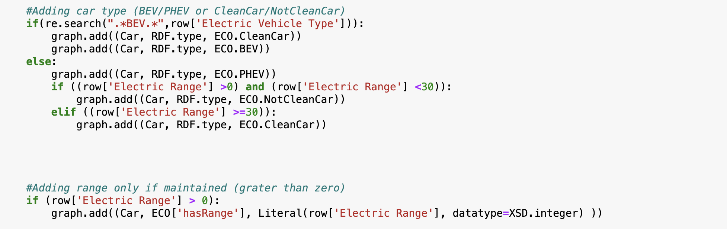
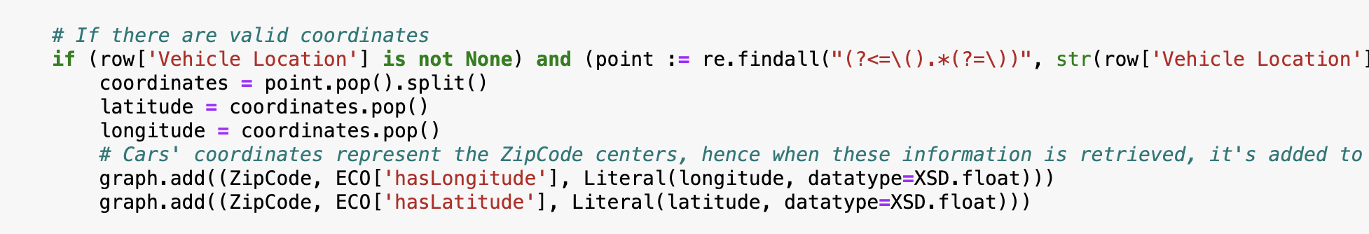
Serialization (2)
Car processing:
Car classification:
Car location:

